Slide 1


Submitted by: Sachin Sharma(2021a1r124) Shivam Dhar(2021a1r132) Preet Paul Sharma(2021a1r133) Superb Jain(2021a1r134) Ranbir Singh(2021a1r139)
Priority Scheduling Algorithm
Submitted to:
Ms. Pragti Jamwal

Slide 2
Priority
Scheduling
Algorithm

Slide 3
Overview
Basic Concepts
Scheduling Criteria
Scheduling Algorithms
Example of Priority Scheduling
Advantages & Disadvantages

Slide 4
Basic Concepts
Main objective of multiprogramming is to keep on running processes all the time for maximum CPU utilization.
Scheduling is fundamental function of OS.
The task of selecting the processes in memory that are ready to execute, and allocating them to the CPU is performed by the CPU Scheduler.

Slide 5
CPU Scheduler
CPU scheduling decisions may take place when a process:
1. Switches from running to waiting state
2. Switches from running to ready state
3. Switches from waiting to ready
4. Terminates
Scheduling under 1 and 4 is non preemptive.
All other scheduling is preemptive.

Slide 6
CPU Scheduler (Cont..)
Non preemptive :
Once a process is allocated the CPU, it does not leave unless: it has to wait.
E.g. : for 1/0 request it terminates
Preemptive :
OS can force (preempt) a process from CPU at anytime
E.g. : to allocate CPU to another higher-priority process

Slide 7
Scheduling Criteria
CPU utilization: keep the CPU as busy as possible
Maximize
Throughput: No of processes that complete their execution per time unit
Maximize
Turnaround time : amount of time to execute a particular process (time from submission to termination).
Minimize

Slide 8
Scheduling Criteria (Cont..)
Waiting time: amount of time a process has been waiting in the ready queue (sum of time waiting in ready queue ready queue).
Minimize
Response time — amount of time it takes from when submitted until the first response is a request was produced, output (for time-sharing environment)
Minimize

Slide 9
Scheduling Algorithms
First Come, First Served
Shortest Job First
Priority
Round Robin

Slide 10
Priority
A priority number (integer) is associated with each process.
Lager the CPU burst lower the priority.
The CPU is allocated to the process with the highest priority
Starvation (Infinity blocking): low priority processes may never execute.
Aging : as time progresses increase the priority of the process.

Slide 11
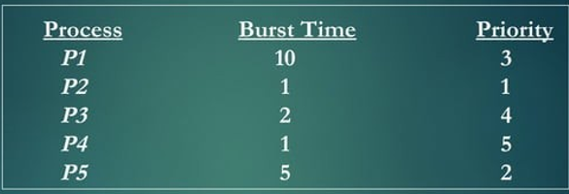
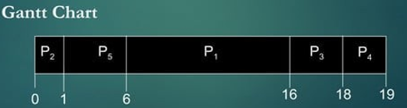

Example of Priority Scheduling (Non- Preemptive)

Slide 12
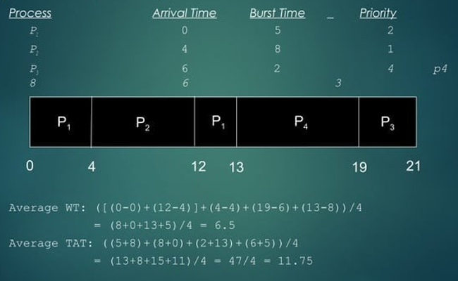
Example of Priority Scheduling (Preemptive)

Slide 13
Advantages of Priority
Easy to use
User friendly
Aging :- As time increases , increase in the priority of a process .
Simplicity .
Suitable for applications with varying time and resource requirement .

Slide 14
Disadvantages of Priority
If system eventually crashes , all low priority processes get lost .
Indefinite blocking or Starvation .

Slide 15









